Slide 1
Machine Learning Model Readout
Xinran Chen, Tianyu Han, Ying Hong,
Siyu Shen, Shiyuan Xu
From Columbia MS Data Science

Slide 2
Agenda
Machine Learning Model Selection
Model Results
Next Steps

Slide 3
Model Selection
Random Forest
Support Vector Machine

Slide 4
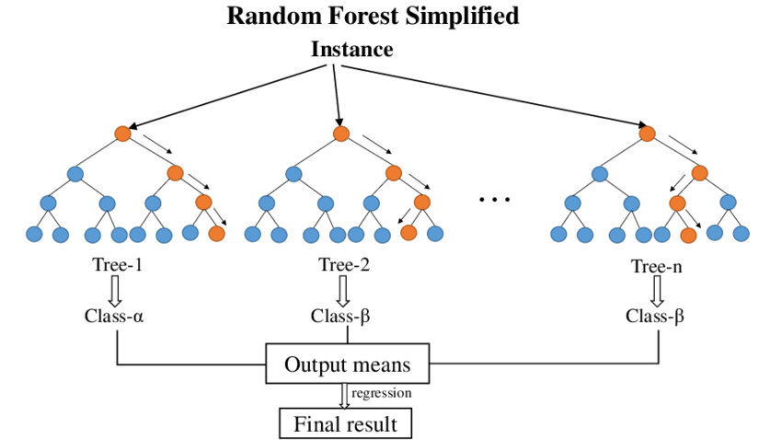
Model Intro - Random Forest
Random Forest operates by leveraging a collection of decision-making models known as decision trees, each of which focuses on a different aspect of the problem. These trees are constructed in a slightly random manner, introducing diversity and reducing the risk of overfitting, ultimately leading to more reliable results.

Slide 5
Model Performance Evaluation Metrics
Precision: measures the accuracy of positive predictions
Recall: measures the model's ability to correctly identify positive instances
F1-score: the harmonic mean of precision and recall.

Slide 6
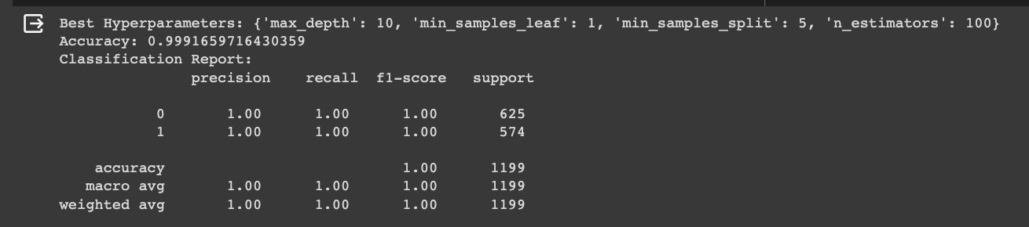
Model Results - Random Forest
The Random Forest classifier, after hyperparameter tuning and oversampling, performs exceptionally well on the test data. It achieves almost perfect accuracy, precision, recall, and F1-scores for both classes.

Slide 7
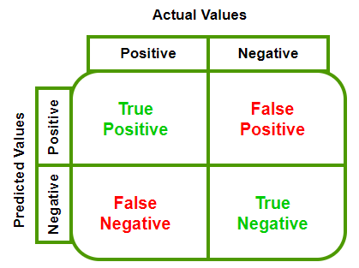
Confusion Matrix
Confusion Matrix provides a summary of the model's predictions by comparing them to the actual outcomes.
True Positives (TP): The number of correct positive predictions made by the model.
True Negatives (TN): The number of correct negative predictions made by the model.
False Positives (FP): The number of incorrect positive predictions made by the model (Type I error).
False Negatives (FN): The number of incorrect negative predictions made by the model (Type II error).

Slide 8
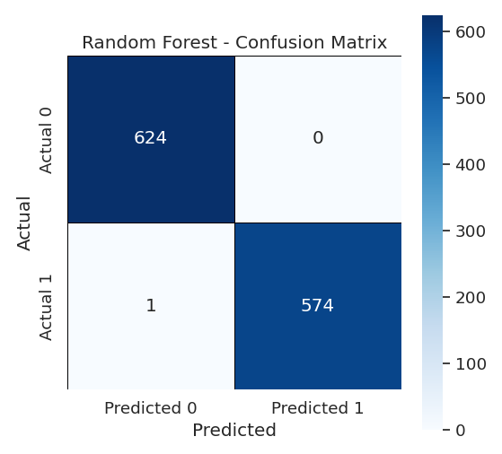
Confusion Matrix - Random Forest
The confusion matrix reveals that the model correctly classifies the vast majority of samples, with minimal misclassifications.
The results indicate that the model's ability to generalize to unseen data is very high, and it is well-equipped to classify the target variable 'Psoriasis' effectively.

Slide 9
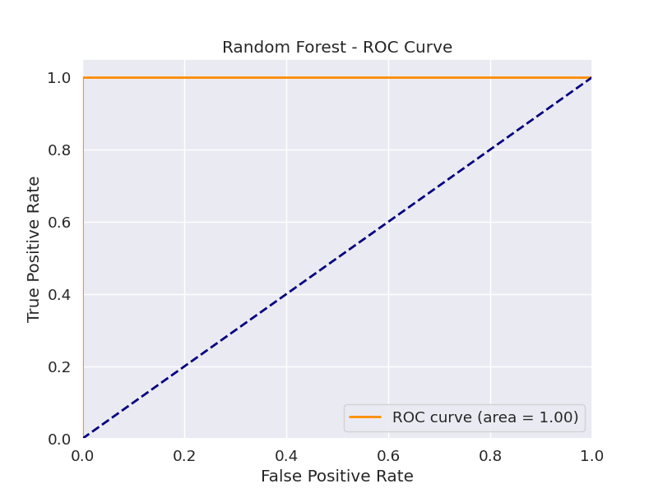
ROC Curve - Random Forest

Slide 10
Feature Importance
Feature importance is a concept in machine learning that helps us understand the significance of different input variables (features) in making predictions or decisions within a model. It provides insights into which features contribute the most to the model's performance and how they influence the model's output.

Slide 11
Feature Importance - Random Forest
Top 4 Most Important Features - Random Forest:
BMXHT: Standing Height (cm)
RIDAGEEX: Exam Age in Months
BMXBMI: Body Mass Index (kg/m**2)
LBDVIDMS: Vitamin D (nmol/L)

Slide 12
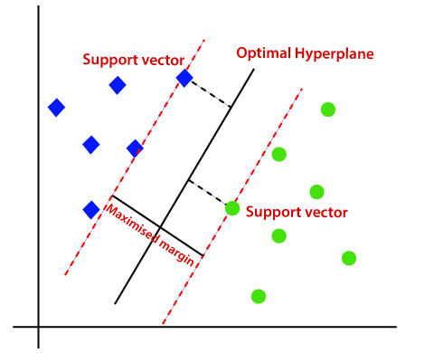
Model Intro - SVM (Support Vector Machine)
SVM aims to find the best possible boundary, or "hyperplane," that separates different categories in data. What sets SVM apart is its ability to identify the optimal hyperplane that maximizes the margin between different data points, leading to a robust and accurate classification.

Slide 13
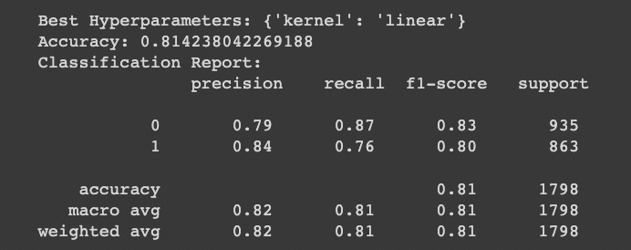
Model Results - SVM
The weighted average F1-score is 0.82, indicating a good balance between precision and recall.

Slide 14
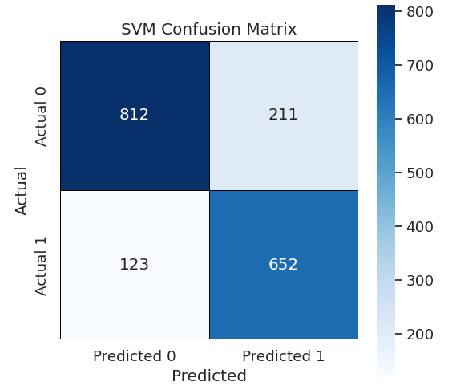
Confusion Matrix - SVM
True Positives (TP): 652 cases of actual Psoriasis (1) correctly predicted as Psoriasis.
True Negatives (TN): 812 cases of non-Psoriasis (0) correctly predicted as non-Psoriasis.
False Positives (FP): 211 cases of non-Psoriasis incorrectly predicted as Psoriasis.
False Negatives (FN): 123 cases of Psoriasis incorrectly predicted as non-Psoriasis.
A large number of true positives and true negatives along with relatively low false positives and false negatives indicate a model with good predictive power.

Slide 15
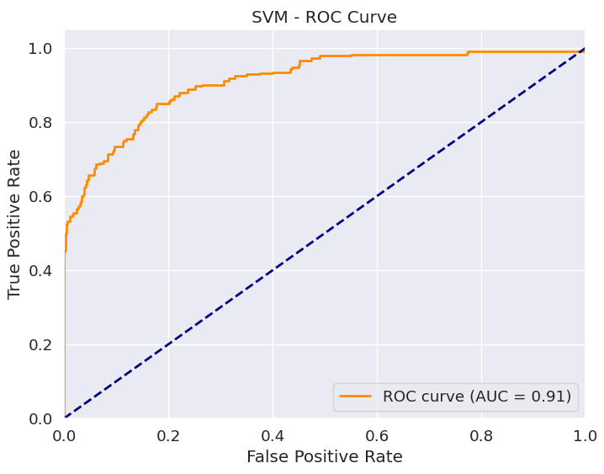
ROC Curve - SVM
AUC is a scalar value that quantifies the overall performance of binary classification model.
An AUC of 0.91 is high and indicates that the model is doing a very good job at distinguishing between the positive and negative classes.

Slide 16
Feature Importance - SVM
Top 4 Most Important Features – SVM:
RIAGENDR: Gender
SMQ020: Smoked at least 100 cigarettes in life
DEQ038G: In the past yr did you have sunburn?
ALQ150: Ever have 5 or more drinks every day?

Slide 17
Next Steps
Integrate more data
Explore other ML models
???

